Slide 1
Core Methods in Educational Data Mining
EDUC6191 Fall 2022

Slide 2
Questions about Basic HW 1?

Slide 3
Reminders
You don’t have to do it perfectly, you just have to do it
You will NOT be penalized for using hints (appropriately)
If you run into trouble, feel free to email me or, better yet, use the discussion forum

Slide 4
Let’s get warmed up

Slide 5
What is big data?

Slide 6
Some definitions
“Big data” is data big enough that traditional statistical significance testing becomes useless
“Big data” is data too big to input into a traditional relational database
“Big data” is data too big to work with on a single machine

Slide 7
A moving target
2004: I reported a data set with 31,450 data points. People were impressed.
2014: A reviewer in an education journal criticized me for referring to 817,485 data points as “big data”.

Slide 8
Not just big but open
More and more educational data sets can be accessed by the public
The EDM Society even runs an annual best open data set competition
Very different than how things used to be

Slide 9
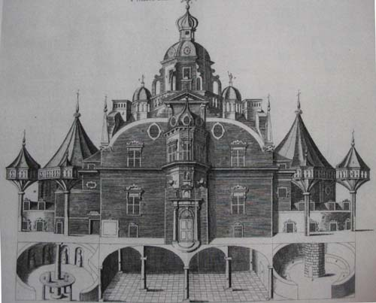
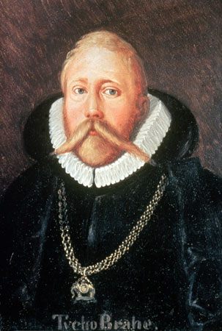
Tycho Brahe
Spent 24 years observing the sky from a custom-built castle on the island of Hven

Slide 10

Johannes Kepler
Had to take a job with Brahe to get Brahe’s data

Slide 11
Johannes Kepler
Had to take a job with Brahe to get Brahe’s data
Only got unrestricted access to data…

Slide 12
Johannes Kepler
Had to take a job with Brahe to get Brahe’s data
Only got unrestricted access to data… when Brahe died

Slide 13
Johannes Kepler
Had to take a job with Brahe to get Brahe’s data
Only got unrestricted access to data… when Brahe died
and Kepler stole the data and fled to Germany

Slide 14
What are the types of EDM method?
According to Baker (any version)
Top-level first

Slide 15
What type of method are each of these? (According to Baker)
Classification
Regression
Correlation Mining
Factor Analysis
Domain Structure Discovery
Network Analysis
Clustering
Association rule mining
Sequential pattern mining
Latent Knowledge Estimation
Causal data mining

Slide 16
Questions? Comments?

Slide 17
Today
Prediction Modeling
Classic Categories
Classification
Regression
Density Estimation

Slide 18
What is a classifier?

Slide 19
What is a regressor?

Slide 20
Density Estimator
Predicts a probability density function
Not used much in education
Used more in other domains

Slide 21
But things have moved really fast recently…
From predicting single values, to predicting sequences, to predicting n-dimensional matrices

Slide 22
Transformer/Foundation Models
Who here can tell us what a transformer model/foundation model is?

Slide 23
Transformer/Foundation Models
Some examples
BERT, MathBERT, GPT-2, GPT-3, DALL-E 2, StableDiffusion, …, …

Slide 24
Transformer/Foundation Models
Can predict
Words
Sentences
Pixels
Computer program text
Mathematical equations
Anything?

Slide 25
Transformer/Foundation Models
Can predict
Words
Sentences
Pixels
Computer program text
Mathematical equations
Anything?
And, in a sudden light-switch transformation, prediction becomes generation

Slide 26
GPT-3 Chatbot (courtesy of Kelsey Piper)
If I injured my hand and I couldn’t afford to go to the doctor, would it make sense for me to replace it with a new hand I got at the grocery store?
GPT-3: No, that would not make sense. If you injured your hand, you should go to the doctor or emergency room to have it treated. You should not try to replace it with a new hand from the grocery store.

Slide 27
AI Dungeon (GPT-2)
You are a friendly blanket. You live in a nice warm house with some nice humans. You like cuddling and keeping people warm. But you don’t want to be a "blanket baby" anymore, so you have decided that it is time for you to leave this place. … > You look for a job as a blanket. You find a job searching for blankets in the classifieds. You start reading the ads. Most of them are for low paying menial jobs, but you find three that look interesting. > You read the best ad. You find the best job listed: WANTED: One blanket for sleeping on the cold ground during the night. Must be able to fold yourself into one-third of the blanket's volume. > You call the job ad. … A: The number you have called goes through to the "Blanket Museum“ where a robotic voice informs you that the number you have called is not in their phone book.

Slide 28
AI Dungeon (GPT-2)
… > You go inside museum. You walk into the museum and see a robotic voice greet you. "Hello, and welcome to the Blanket Museum!" it says. > You say "I want a job" A: You are asked some questions and then fitted for a security uniform, just like in the movies. You are given a tour of the museum and the exhibits. > You put on security uniform. > You fold yourself. You find that you can easily turn the security uniform into a small blanket. You spend the rest of your life working at the museum. Every day you spend your time looking after the exhibits and cleaning the building. YOU HAVE DIED

Slide 29
AI Dungeon Harry Potter story

Slide 30

DALL-E 2
"Teddy bears working on new AI research underwater with 1990s technology"

Slide 31
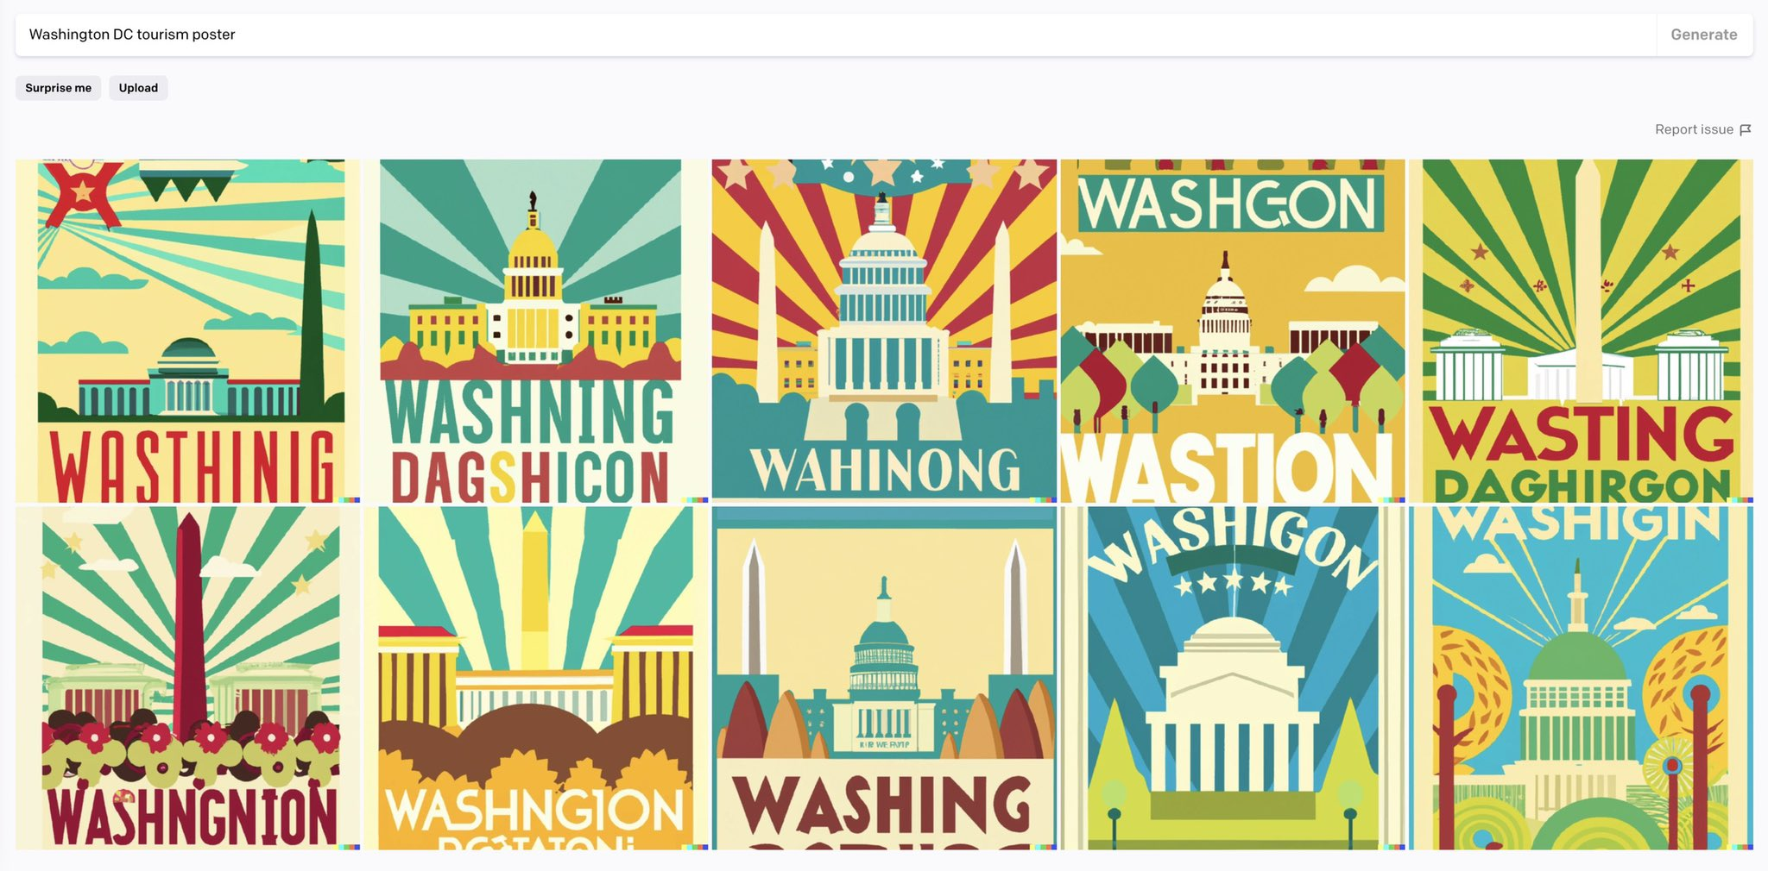
DALL-E 2 Still not perfect (Randall Munro)

Slide 32
Questions? Comments?

Slide 33
The Elephant in the Room
Why not just replace this class with a class about foundation models?
When they succeed, they succeed spectacularly
But…
They can’t do everything (actually, they don’t do most any of the things this class will cover)
Unless you’re using an existing tool, applying them to a specific problem requires programming outside the scope of this class (for now)
When they fail, they fail spectacularly (as our examples show)

Slide 34
We will discuss these models…
On December 1, when we discuss text mining

Slide 35
Questions? Comments?

Slide 36
Let’s look at a very simple regressor
Numhints = 0.12*Pknow + 0.932*Time – 0.11*Totalactions
Skill pknow time totalactions numhints
COMPUTESLOPE 0.2 7 3 ?

Slide 37
Which of the variables has the largest impact on numhints? (Assume they are scaled the same)

Slide 38
However…
These variables are unlikely to be scaled the same!
If Pknow is a probability
From 0 to 1
And time is a number of seconds to respond
From 0 to infinity
Then you can’t interpret the weights in a straightforward fashion
What could you do?

Slide 39
Let’s do another example
Numhints = 0.12*Pknow + 0.932*Time – 0.11*Totalactions
Skill pknow time totalactions numhints
COMPUTESLOPE 0.2 2 35 ?

Slide 40
Is this plausible?

Slide 41
What might you want to do if you got this result in a real system?

Slide 42
Interpreting Regression Models
Let’s quickly review the example from the video

Slide 43
Example of Caveat
Let’s graph the relationship between number of graduate students and number of papers per year

Slide 44
Data

Slide 45
Model
Number of papers = 4 + 2 * # of grad students - 0.1 * (# of grad students)²
But does that actually mean that (# of grad students)² is associated with less publication?
No!

Slide 46
Example of Caveat
(# of grad students)² is actually positively correlated with publications!
r=0.46

Slide 47
Example of Caveat
The relationship is only in the negative direction when the number of graduate students is already in the model…

Slide 48
How would you deal with this?
How can we interpret individual features in a comprehensive model?

Slide 49
The videos discussed a range of algorithms
Linear Regression
Regression Trees
Logistic Regression (a classifier!)
Decision Trees
Decision Rules
Instance-Based Classifiers
Support Vector Machines
Random Forest
Neural Networks/Recurrent Neural Networks
What Transformer/Foundation Models are built on

Slide 50
Questions or comments about any of these?

Slide 51
Has anyone
Used any classification algorithms outside the set discussed/recommended in the videos?
Say more?

Slide 52
A practical question

Slide 53
Should you
Pick one algorithm that seems really appropriate?
Run every algorithm that will actually run for your data?
Something in between?

Slide 54
My typical lab practice
Pick a small number of algorithms that
Have worked on past similar problems
Fit different kinds of patterns from each other

Slide 55
Is it really the algorithm?
Or is it the data you put into it?
We’ll come back to this in the Feature Engineering lecture at the end of the month

Slide 56
Questions? Comments?

Slide 57
Coleman article
Any questions or comments?

Slide 58
Did anyone read Hand article?
Thoughts?

Slide 59
What is Hand’s main thesis?

Slide 60
What is Hand’s main thesis?
“A great many tools have been developed for supervised classification, ranging from early methods such as linear discriminant analysis through to modern developments such as neural networks and support vector machines. A large number of comparative studies have been conducted in attempts to establish the relative superiority of these methods. This paper argues that these comparisons often fail to take into account important aspects of real problems, so that the apparent superiority of more sophisticated methods may be something of an illusion. In particular, simple methods typically yield performance almost as good as more sophisticated methods, to the extent that the difference in performance may be swamped by other sources of uncertainty that generally are not considered in the classical supervised classification paradigm.”

Slide 61
I used to ask the class if they agree with Hand…

Slide 62
I used to ask the class if they agree with Hand…
But

Slide 63
But we can still learn a lot from Hand
Hand notes that for small data sets, simpler algorithms often work just as well or better
And in education, we often have small data sets
We haven’t yet figured out how to leverage web-scale data for a lot of problems in education

Slide 64
The problem of generalizability (Hand)
Data points trained on are not usually drawn from the same distribution
As the data points where the classifier will be applied
Can anyone think of examples of this in education?

Slide 65
Another of Hand’s key arguments
Data points trained on are often treated as certainly true and objective
But they are often arbitrary and uncertain

Slide 66
Another of Hand’s key arguments
Data points trained on are often treated as certainly true and objective
But they are often arbitrary and uncertain
Where might this apply in education?

Slide 67
We will discuss these issues further
Over the next two weeks
As we discuss topics like
Over-fitting and generalizability (next week)
Algorithmic bias (next week)
Diagnostic metrics (in two weeks)

Slide 68
Any other questions or comments?

Slide 69
Next classes
September 15
Behavior and Affect Detection
Basic: Classifier Due
September 22
Diagnostic Metrics
Creative: Behavior Detection Due
September 29 VIRTUAL
Feature Engineering and Distillation
Basic: Diagnostic Metrics Due

Slide 70
The End

